Slide 1
British Airways
Web scraping to gain company insights

Slide 2
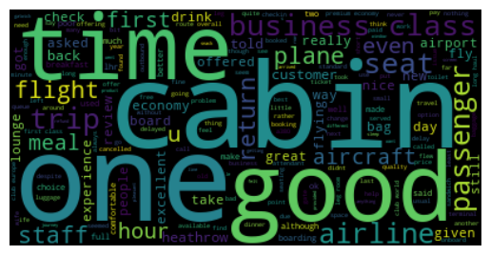
Sentiment Analysis Insights
Analyzed a total of 3804 reviews from the website Skytrax
There are 2506 (65%) positive reviews
There are 1299 (35%) negative reviews
Word cloud of most frequent used words:

